Slide 1
Flying and Judging F3A
SCHEMATIC MANOEUVRE ILLUSTRATIONS
SCHEDULE P-25

Slide 2
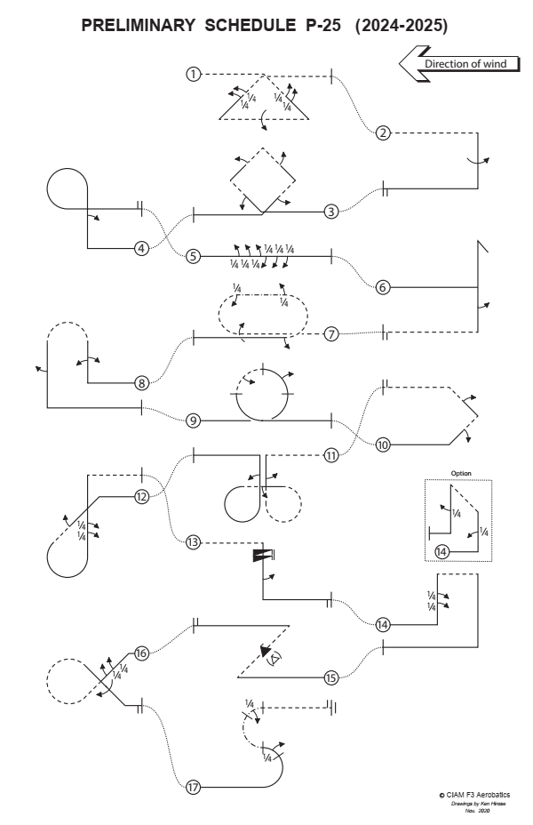
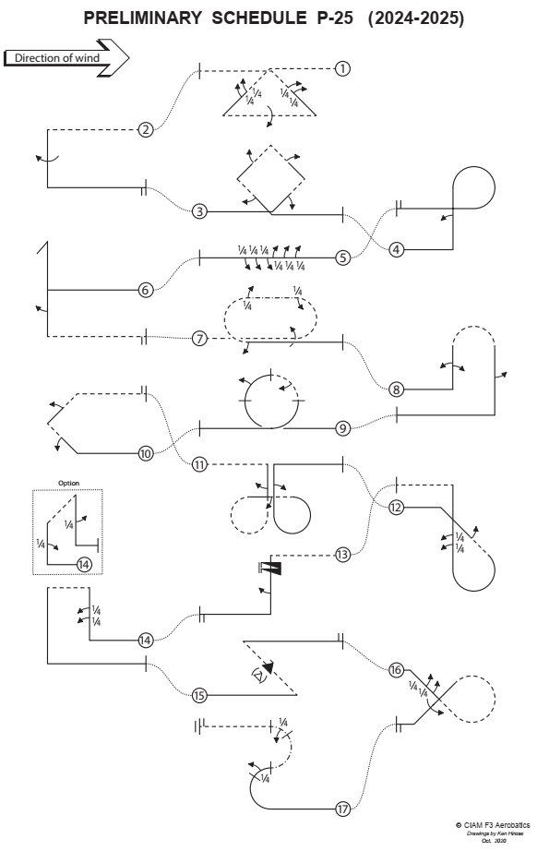

Slide 3
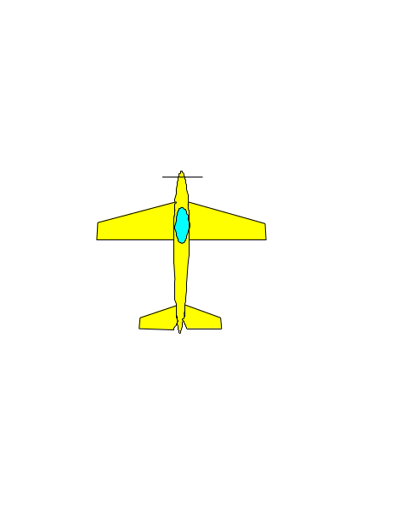
Explanations:
Aircraft upright
Aircraft inverted
Aircraft in Knife-Edge View from Top
Aircraft in Knife-Edge View from Below
part roll
half roll
roll
¼
pos. spin
neg. spin
snap rolls
pos.
neg.
reference points

Slide 4

Take-off procedure
( not judged, not scored )
wind
120⁰
Safety line

Slide 5
P-25.01 Triangle from Top with two quarter rolls, roll, two quarter rolls
¼ roll
¼ roll
¼ roll
¼ roll
roll
From inverted, in the center pull through a one eighth loop into a forty-five degree downline, perform consecutively two quarter rolls, push through a three eighths loop, perform a roll, push through a three eighths loop into a forty-five degree upline, perform consecutively two quarter rolls, pull through a one eighth loop, exit inverted.
P-25.01.01

Slide 6
P-25.01 Triangle from Top with two quarter rolls, roll, two quarter rolls
¼ rolls centered on
middle of the line.
¼
¼
All radii are equal.
¼
¼
Lines between part rolls must be short and of recognisable length.
45°
Roll in the center.
P-25.01.02

Slide 7
P-25.02 Half Square Loop with roll
roll
From inverted, pull through a quarter loop into a vertical downline, perform a roll, pull through a quarter loop, exit upright.
P-25.02.01

Slide 8
P-25.02 Half Square Loop with roll
Roll on middle of the line.
All radii are equal.
P-25.02.01

Slide 9
P-25.03 Square Loop on corner with half roll, half roll, half roll, half roll
½ roll
½ roll
½ roll
½ roll
From upright, in the center pull through a one eighth loop into a forty-five degree upline, perform a half roll, push through a quarter loop into a forty-five degree upline, perform a half roll, pull through a quarter loop into a forty-five degree downline, perform a half roll, push through a quarter loop into a forty-five degree downline, perform a half roll, pull through a one eighth loop, exit upright.
P-25.03.01

Slide 10
P-25.03 Square Loop on corner with half roll, half roll, half roll, half roll
½ rolls on middle of the line.
All radii are equal.
45°
P-25.03.02

Slide 11
P25.04 Figure Nine with half roll
½ roll
From upright, pull through a quarter loop into a vertical upline, perform a half roll, pull through a three quarter loop, exit upright.
P-25.04.01

Slide 12
P25.04 Figure Nine with half roll
½ roll on middle of the line.
All radii are equal.
P-25.04.02

Slide 13
P-25.05 Roll Combination with three quarter rolls, three quarter rolls in opposite direction
¼
roll
¼
roll
¼
roll
¼
roll
¼
roll
¼
roll
From upright, perform consecutively three quarter rolls, followed by three consecutive quarter rolls in opposite direction, exit upright.
P-25.05.01

Slide 14
P-25.05 Roll Combination with three quarter rolls, three quarter rolls in opposite direction
P-25.05 Roll Combination with three quarter rolls, three quarter rolls in opposite direction
Lines between part rolls must be short
and of equal length.
¼
¼
¼
¼
¼
¼
Between rolls and part rolls in opposite direction there must be no line.
P-25.05.02

Slide 15
P-25.06 Stall Turn with half roll
Stop
before pivot
(slight hesitation)
Pivot on CG
½ roll
From upright, pull through a quarter loop into a vertical upline, perform a stall turn into a vertical downline, perform a half roll, push through a quarter loop, exit inverted.
P-25.06.01

Slide 16
P-25.06 Stall Turn with half roll
Stop
before pivot
(slight hesitation)
Two wing spans or more
– zero points!
Pivot on CG
½ roll on middle of the line.
All radii are equal.
P-25.06.02

Slide 17
P-25.07 Double Immelman with roll, quarter roll,
quarter roll, half roll
¼ roll
¼ roll
½ roll
From inverted, perform a roll, push through a half loop, perform a quarter roll into knife-edge flight, perform a quarter roll (back to upright flight), push through a half loop, perform a half roll, exit upright.
P-25.07.01

Slide 18
P-25.07 Double Immelman with roll, quarter roll,
quarter roll, half roll
The first ¼ roll must follow immediately after the half loop.
¼
During the knife edge
the wing must be in the vertical plane.
¼
The second half loop must follow immediately after the ¼ roll.
The half loop must follow immediately after the roll.
All radii are equal.
The ½ roll must follow immediately after the second half loop.
½ roll
P-25.07.02

Slide 19
P-25.08 Humpty Bump with two consecutive half rolls in opposite direction, half roll
½ roll
½ roll
½ roll
From upright, pull through a quarter loop into a vertical upline, perform consecutively two half rolls in opposite direction, push through a half loop into a vertical downline, perform a half roll, pull through a quarter loop, exit upright.
P-25.08.01

Slide 20
P-25.08 Humpty Bump with two consecutive half rolls in opposite direction, half roll
½ rolls on middle of the line.
Between rolls and part rolls in
opposite direction there must be no line.
All radii are equal.
P-25.08.02

Slide 21
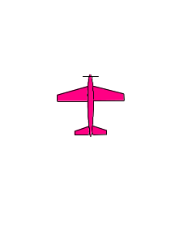
P-25.09 Loop with two half rolls integrated
½ roll integrated
½ roll integrated
From upright, pull through a loop while integrating a half roll in the second ninety degrees and another half roll in opposite direction in the third ninety, exit upright.
P-25.09.01

Slide 22
P-25.09 Loop with two half rolls integrated
½ roll integrated
90°
90°
½ roll integrated
½ rolls must be integrated
on circular flightpath of
the quarter loops.
Loop must be round.
P-25.09.02

Slide 23
P-25.10 Half Square Loop on Corner with half roll, half roll
½ roll
½ roll
From upright, pull through a one eighth loop into a forty-five degree upline, perform a half roll, push through a quarter loop into a forty-five degree upline, perform a half roll, pull through a one eighth loop, exit inverted.
P-25.10.01

Slide 24
P-25.10 Half Square Loop on Corner with half roll, half roll
½ rolls on middle of the line.
All radii are equal.
45°
P-25.10.02

Slide 25
P-25.11 Half Cloverleaf with half roll, half roll, half roll
½ roll
½ roll
½ roll
From inverted, pull through a quarter loop into a vertical downline, perform a half roll, push through a three quarter loop into a horizontal line, perform a half roll, pull through a three quarter loop into a vertical upline, perform a half roll, push through a quarter loop, exit upright.
P-25.11.01

Slide 26
P-25.11 Half Cloverleaf with half roll, half roll, half roll
All radii are equal.
½ rolls on middle of the line.
P-25.11.02

Slide 27
P-25.12 Reverse Figure ET with half roll, two quarter rolls
½ roll
¼ roll
¼ roll
From upright, push through a one eighth loop into a forty-five degree downline, perform a half roll, pull through five eighths loop into a vertical upline, perform consecutively two quarter rolls, pull through a quarter loop, exit inverted.
P-25.12.01

Slide 28
P-25.12 Reverse Figure ET with half roll, two quarter rolls
½ roll on middle of the line.
¼ rolls centered on middle of the line.
¼
Lines between part rolls must be short
and of recogniseable length.
¼
All radii are equal.
P-25.12.02

Slide 29
P-25.13 Inverted Spin two turns, half roll
½ roll
From inverted, perform an inverted spin with two turns, perform a vertical downline, perform a half roll, pull through a quarter loop, exit upright.
P-25.13.02

Slide 30
P-25.13 Inverted Spin two turns, half roll
Snap entry - 0 points!
Spiral dive - 0 points!
Forced entry: downgrade.
Line after the spins.
P-25.13.01

Slide 31
P-25.14 Top hat with two quarter rolls. Option: Top hat with quarter roll, quarter roll.
¼ roll
¼ roll
From upright, pull through a quarter loop into a vertical upline, perform consecutively two quarter rolls, pull through a quarter loop into a horizontal line, pull through a quarter loop into a vertical downline, pull through a quarter loop, exit upright.
P-25.14.01

Slide 32
P-25.14 Top hat with two quarter rolls. Option: Top hat with quarter roll, quarter roll.
¼ rolls centered on middle of the line.
Lines between part rolls must be short
and of recogniseable length.
¼
¼
All radii are equal.
P-25.14.02

Slide 33
P-25.14 Top hat with two quarter rolls. Option: Top hat with quarter roll, quarter roll.
Option
¼ roll
¼ roll
Option: From upright, pull through a quarter loop into a vertical upline, perform a quarter roll, pull through a quarter loop into a horiontal line, pull through a quarter loop into a vertical downline, perform a quarter roll, pull through a quarter loop, exit upright.
P-25.14.03

Slide 34
P-25.14 Top hat with two quarter rolls. Option: Top hat with quarter roll, quarter roll.
Option
¼ rolls on middle of the line.
¼
All radii are equal.
¼
P-25.14.04

Slide 35
P-25.15 Figure Z with snap roll
snap roll
( )
From upright, pull through a three eighths loop into a forty-five degree upline, perform a snap roll, push through a three eighths loop, exit upright.
P-25.15.01

Slide 36
P-25.15 Figure Z with snap roll
Snap roll may be positive or negative.
Snap roll on middle of the line.
If snap roll = barrel roll or aileron roll:
Severe downgrade > 5 pts.
( )
All radii are equal.
45°
P-25.15.02

Slide 37
P-25.16 Comet with two quarter rolls, roll
¼ roll
¼ roll
roll
From upright, push through a one eighth loop into a forty five degree downline, perform consecutively two ¼ rolls, push through a three quarter loop into a forty-five degree downline, perform a roll, pull through a one eighth loop, exit upright.
P-25.16.01

Slide 38
P-25.16 Comet with two quarter rolls, roll
¼
Rolls centered on
middle of the lines.
¼
Lines between part rolls must be short and of recognisable length.
All radii are equal.
Rolls on middle of the lines, but not necessarily in the center of the manoeuvre.
P-25.16.02

Slide 39
P-25.17 Figure S with quarter roll, quarter roll
¼ roll integrated
45°
45°
¼ roll integrated
45°
From upright, pull through a half loop while integrating a quarter roll over the top forty-five degrees, perform a half knife-edge loop ending on top level, while integrating a quarter roll over the top forty-five degrees, exit inverted.
P-25.17.01

Slide 40
P-25.17 Figure S with quarter roll, quarter roll
¼ roll integrated
Part loops must be round.
45°
The ¼ rolls must be integrated on circular flightpath of the 45° segments of the part loops.
¼ roll integrated
Radii of the part loops are equal.
45°
P-25.17.02

Slide 41
Landing procedure
( not judged, not scored )
The direction of the landing may be different to the take off.
wind
120⁰
Safety line

Slide 42
Forget WHO is flying
(friend, rival, countryman, flier from other nation)
Forget WHAT is flying
(2-stroke, 4-stroke, electric)
LOOK ONLY AT LINES DESCRIBED IN THE SKY!
Bob Skinner
Thank you!
© Peter Uhlig, February 2023

