Slide 1
Flying and Judging F3A
SCHEMATIC MANOEUVRE ILLUSTRATIONS
SCHEDULE F-27

Slide 2
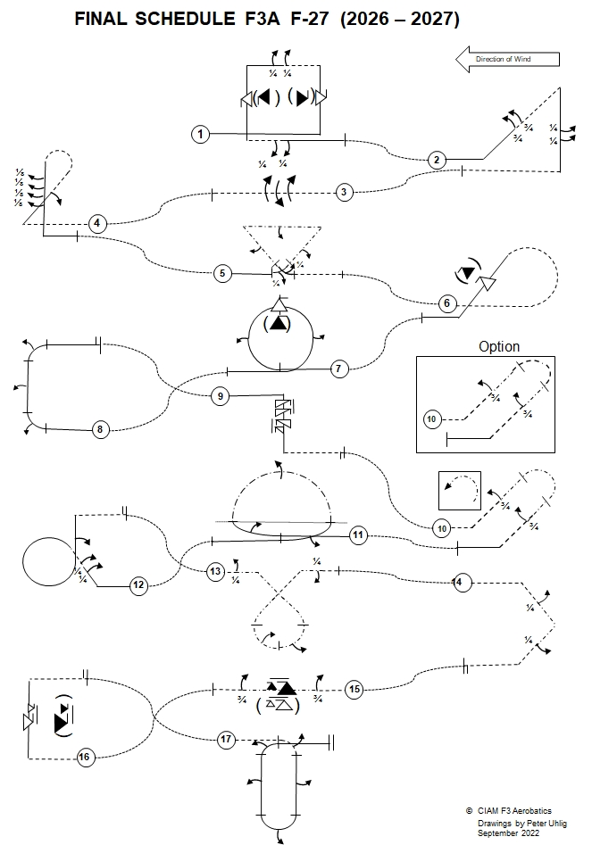
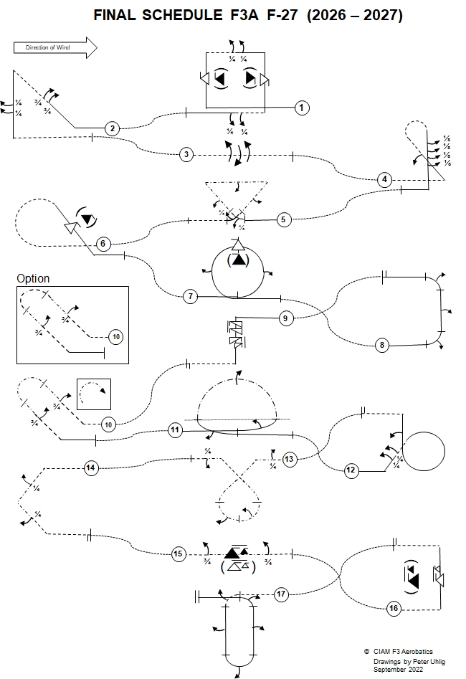

Slide 3
Explanations:
Aircraft upright
Aircraft inverted
Aircraft in Knife-Edge View from Top
Aircraft in Knife-Edge View from Below
part roll
half roll
roll
¼
pos. spin
neg. spin
snap rolls
pos.
neg.
reference points

Slide 4
Take-off procedure
( not judged, not scored )
wind
120⁰
Safety line

Slide 5
F-27.01 Square Loop with snap roll, two quarter rolls, snap roll, two quarter rolls
¼ roll
¼ roll
snap roll
( )
snap roll
( )
¼ roll
¼ roll
From upright, fly past centre, pull through a ¼ loop into a vertical upline, perform a snap roll, pull through a ¼ loop, perform consecutively two ¼ rolls, push through a ¼ loop into a vertical downline, perform a snap roll, push through a ¼ loop, perform consecutively two ¼ rolls, exit upright.
F-27.01.01

Slide 6
F-27.01 Square Loop with snap roll, two quarter rolls, snap roll, two quarter rolls
¼
¼
All radii are equal.
Snap rolls and ¼ rolls centered on middle of the lines.
Lines between part rolls
must be short and of equal length.
Snap rolls may be positive or negative.
snap roll
snap roll
( )
( )
If snap roll = barrel roll or aileron roll:
Severe downgrade > 5 pts.
Entry and exit must be at the same altitude.
¼
¼
F-27.01.02

Slide 7
F-27.02 Reverse Shark Fin with two three quarter rolls,
two quarter rolls
¼ roll
¾ roll
¼ roll
¾ roll
From upright, pull through a ⅛ loop into a 45° upline, perform consecutively two ¾ rolls, pull through a ⅜ loop into a vertical downline, perform consecutively two ¼ rolls, push through a ¼ loop, exit inverted.
F-27.02.01

Slide 8
F-27.02 Reverse Shark Fin with two three quarter rolls,
two quarter rolls
Part rolls centered on middle of the lines.
Lines between part rolls must be short and of recognizable length.
¼
¾
¼
¾
All radii are equal.
45°
F-27.02.02

Slide 9
F-27.03 Roll Combination with three rolls in opposite directions
roll
roll
roll
From inverted, perform consecutively a roll, a second roll in opposite direction, a third roll in opposite direction to the second roll, exit inverted.
F-27.03.01

Slide 10
F-27.03 Roll Combination with three rolls in opposite directions
Between rolls in opposite direction there must be no line.
roll
roll
roll
F-27.03.02

Slide 11
F-27.04 Figure ET with half roll, four one eighth rolls
⅛ roll
⅛ roll
45°
⅛ roll
⅛ roll
½ roll
From inverted, push through a ⅜ loop into a 45° upline, perform a ½ roll, push through a ⅝ loop into a vertical downline, perform consecutively four ⅛ rolls, pull through a ¼ loop, exit upright.
F-27.04.01

Slide 12
F-27.04 Figure ET with half roll, four one eighth rolls
½ roll on middle of the line.
⅛
⅛ rolls centered on middle of the line.
⅛
⅛
Lines between part rolls must be short
and of equal length.
⅛
All radii are equal.
F-27.04.02

Slide 13
F-27.05 Triangle with quarter roll integrated, half roll, half roll, half roll, quarter roll integrated
½ roll
½ roll
¼ roll integrated
½ roll
¼ roll integrated
From upright, at centre, pull through a ⅛ loop while integrating a ¼ roll into a 45 ° knife-edge upline, perform a ½ roll, perform a ⅜ knife-edge loop, perform a ½ roll, perform a ⅜ knife-edge loop into a 45° knife edge downline, perform a ½ roll, perform a ⅛ knife edge loop while integrating a ¼ roll, exit inverted.
F-27.05.01

Slide 14
F-27.05 Triangle with quarter roll integrated, half roll, half roll, half roll, quarter roll integrated
During Knife Edge the wing must be in the vertical plane.
½ rolls on middle of the line.
All radii are equal.
Part rolls integrated on circular flightpath of the part loops.
¼ roll integrated
45°
¼ roll integrated
F-27.05.02

Slide 15
F-27.06 Half Cuban eight with snap roll
snap roll
( )
From inverted push through a ⅝ loop into a 45° downline, perform a snap roll, pull through a ⅛ loop, exit upright.
F-27.06.01

Slide 16
F-27.06 Half Cuban eight with snap roll
Snap roll on middle of the line.
Snap roll may be positive or negative.
If snap roll = barrel roll or aileron roll:
Severe downgrade > 5 pts.
( )
All radii are equal.
45°
From inverted push through a ⅝ loop into a 45° downline, perform a snap roll, pull through a ⅛ loop, exit upright.
F-27.06.02

Slide 17
F-27.07 Loop with half roll integrated, snap roll, half roll integrated
( )
½ roll integrated
½ roll integrated
½ roll
From upright, pull through a loop while integrating a ½ roll in the first half of the loop, perform a snap roll, finish the loop while integrating another ½ roll in the second half of the loop, exit upright.
Note: The direction of the integrated ½ rolls and the snap rolls is at the pilot’s discretion.
F-27.07.01

Slide 18
F-27.07 Loop with half roll integrated, snap roll, half roll integrated
Loop must be round.
Snap roll may be positive or negative.
The ½ rolls must be integrated on circular flightpath of the half loops.
If snap roll = barrel roll or aileron roll:
Severe downgrade > 5 pts.
( )
½ roll integrated
½ roll integrated
The direction of the integrated ½ rolls and the snap roll is at the pilot’s discretion.
½ roll
F-27.07.02

Slide 19
F-27.08 Half Square Loop with half roll integrated, half roll, half roll integrated
½ roll integrated
½ roll
½ roll integrated
From upright, pull through a ¼ loop into a vertical upline while integrating a ½ roll, perform a ½ roll, pull through a ¼ loop while integrating a ½ roll, exit upright.
F-27.08.01

Slide 20
F-27.08 Half Square Loop with half roll integrated, half roll, half roll integrated
The ½ rolls must be integrated on circular flightpath of the ¼ loops.
½ roll integrated
½ roll on middle of the line.
All radii are equal.
½ roll integrated
F-27.08.02

Slide 21
F-27.09 Spin with two turns, one and a half turn in opposite direction
From upright, perform a two turn spin, perform immediately another 1 ½ turn spin in the opposite direction, perform a vertical downline, push through a ¼ loop, exit inverted.
F-27.09.01

Slide 22
F-27.09 Spin with two turns, one and a half turn in opposite direction
Snap entry - 0 points!
Spin reversal must be immediate..
Spiral dive - 0 points!
Forced entry: downgrade.
Line after the spins.
F-27.09.02

Slide 23
F-27.10 Trombone with three quarter roll, three quarter roll. Option: Fighter turn with three quarter roll, three quarter roll
¾ roll
¾ roll
From inverted, push through a ⅛ loop into a 45° upline, perform a ¾ roll, perform a half knife-edge loop into a 45° knife-edge downline, perform a ¾ roll, pull through a ⅛ loop, exit upright.
F-27.10.01

Slide 24
F-27.10 Trombone with three quarter roll, three quarter roll. Option: Fighter turn with three quarter roll, three quarter roll
or
¾ roll
¾ roll
From inverted, push through a ⅛ loop into a 45° upline, perform a ¾ roll, perform a half knife-edge loop into a 45° knife-edge downline, perform a ¾ roll, pull through a ⅛ loop, exit upright.
F-27.10.02

Slide 25
F-27.10 Trombone with three quarter roll, three quarter roll. Option: Fighter turn with three quarter roll, three quarter roll
Part rolls on middle of the line.
During Knife Edge the wing must be in the vertical plane.
¾
All radii are equal.
¾
45°
F-27.10.03

Slide 26
F-27.10 Trombone with three quarter roll, three quarter roll. Option: Fighter turn with three quarter roll, three quarter roll
Option
¾ roll
¾ roll
From inverted, push through a ⅛ loop into a 45° upline, perform a ¾ roll, perform a half pushed knife edge circle into a 45° knife-edge downline, perform a ¾ roll, pull through a ⅛ loop, exit upright.
F-27.10.04

Slide 27
F-27.10 Trombone with three quarter roll, three quarter roll. Option: Fighter turn with three quarter roll, three quarter roll
Option
wing 45°
¾ rolls on middle of the line.
¾ roll
The radii of the part loops are equal.
¾ roll
F-27.10.05

Slide 28
F-27.11 Rolling Circle Rolling Loop Combination
roll integrated
½ roll integrated
½ roll integrated
From upright, in the centre, perform a ¼ .circle while integrating a half roll to the inside, push through a ¼ loop, into a half knife-edge loop while integrating a roll, push through a ¼ loop, perform a ¼ circle while integrating a ½ roll to the outside, exit upright.
Note: There are no straight lines in the manoeuvre (except entry and exit lines)
F-27.11.01

Slide 29
F-27.11 Rolling Circle Rolling Loop Combination
roll integrated
Part rolls integrated on circular flightpath of the part circles.
Roll integrated on circular flightpath of the part loop.
There are no straight lines in the manoeuvre (except entry and exit lines)
½ roll inside integrated
½ roll out side integrated
F-27.11.02

Slide 30
F-27.12 Inverted Figure ET with two quarter rolls, half roll
½ roll
¼ roll
¼ roll
From upright, pull through a ⅛ loop into a 45° upline, perform consecutively two ¼ rolls, pull through a ⅞ loop into a vertical upline, perform a ½ roll, pull through a ¼ loop, exit inverted
F-27.12.01

Slide 31
F-27.12 Inverted Figure ET with two quarter rolls, half roll
Part rolls centered on middle of the line.
Lines between part rolls must be short and of recognizable length.
¼
¼
All radii are equal.
F-27.12.02

Slide 32
F-27.13 Inverted Golf Ball with quarter roll half roll integrated, half roll integrated quarter roll
¼ roll
¼ roll
½ roll integrated
½ roll integrated
From inverted, before centre, perform a ¼ roll into knife edge, perform a ⅛ knife edge loop into a 45° downline, perform a ¾ knife edge loop into a 45° knife-edge upline, while integrating two ½ rolls in opposite directions in the lower 180° part of the ¾ loop, perform a ⅛ knife-edge loop, perform a ¼ roll exit inverted.
F-27.13.01

Slide 33
F-27.13 Inverted Golf Ball with quarter roll half roll integrated, half roll integrated quarter roll
¼
¼
During knife-edge flight
the wing must be in the
vertical plane.
45°
½ rolls integrated on circular flightpath of the part loops.
All radii are equal.
½ roll integrated
½ roll integrated
½ rolls integrated must be in opposite direction.
F-27.13.02

Slide 34
F-27.14 Half Square Loop on Corner with quarter roll,
quarter roll
¼ roll
¼ roll
From inverted, pull through a ⅛ loop into a 45° downline, perform a ¼ roll into knife-edge flight, perform a ¼ knife-edge loop into a 45° downline, perform a ¼ roll, push through a ⅛ loop, exit inverted.
F-27.14.01

Slide 35
F-27.14 Half Square Loop on Corner with quarter roll,
quarter roll
¼
¼ rolls on middle of the line.
During knife-edge flight the wing must be in the vertical plane.
All radii are equal.
¼
F-27.14.02

Slide 36
F-27.15 Roll Combination with three quarter roll,
one and half snap roll, three quarter roll
¾ roll
¾ roll
( )
1 ½ snap roll
From inverted, perform a ¾ roll into sustained knife-edge flight, perform 1 ½ snap roll into another sustained knife-edge flight, perform a ¾ roll, exit inverted.
F-27.15.01

Slide 37
F-27.15 Roll Combination with three quarter roll,
one and half snap roll, three quarter roll
Knife-edge lines must be of equal length.
1 ½ snap roll must be centered.
Snap roll may be positive or negative.
During knife-edge flight the wing must be in the vertical plane.
If snap roll = barrel roll or aileron roll:
Severe downgrade > 5 pts.
¾
¾
( )
1 ½
F-27.15.02

Slide 38
F-27.16 Half Square Loop with one and a half snap roll
( )
1 ½ snap roll
From inverted, push through a ¼ loop into a vertical upline, perform a 1 ½ snap roll, pull through a ¼ loop, exit inverted.
F-27.16.01

Slide 39
F-27.16 Half Square Loop with one and a half snap roll
( )
1 ½ snap roll on middle of the line.
1 ½
All radii are equal.
F-27.16.02

Slide 40
F-27.17 Pull-Pull-Pull Humpty Bump half roll integrated, half roll, half roll integrated, half roll, half roll integrated
½ roll integrated
½ roll integrated
½ roll
½ roll
½ roll integrated
From inverted, pull through a ¼ loop into a vertical downline, while integrating a ½ roll, perform a ½ roll, pull through a ½ loop while integrating a ½ roll into a vertical upline, perform a ½ roll, pull through a ¼ loop while integrating a ½ roll, exit upright.
F-27.17.01

Slide 41
F-27.17 Pull-Pull-Pull Humpty Bump half roll integrated, half roll, half roll integrated, half roll, half roll integrated
Entry and exit
must be at the
same altitude.
½ roll inegrated
½ roll integrated
½ rolls must be integrated on circular flightpath of the ¼ loop.
½ rolls middle of the line.
All radii are equal.
½ roll integrated
F-27.17.02

Slide 42
Landing procedure
( not judged, not scored )
The direction of the landing may be different to the take off.
wind
120⁰
Safety line

Slide 43
Forget WHO is flying
(friend, rival, countryman, flier from other nation)
Forget WHAT is flying
(2-stroke, 4-stroke, electric)
LOOK ONLY AT LINES DESCRIBED IN THE SKY!
Bob Skinner
Thank you!
© Peter Uhlig, February 2025

